Slide 1
Physics ccc624
Energy in Our Daily Lives

Slide 2
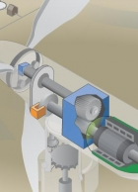
WORKING
This shows how energy in the wind turns two or three propeller-like blades around a rotor. The rotor is connected to the main shaft, which spins a generator to create electricity. Wind turbines are mounted on a tower to capture the most energy. At 100 feet (30 meters) or more above ground, they can take advantage of faster and less turbulent wind. Wind turbines can be used to produce electricity for a single home or building, or they can be connected to an electricity grid (shown here) for more widespread electricity distribution

Slide 3
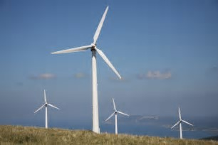
A turbine, like the ones in a wind farm, is a machine that spins around in a moving fluid (liquid or gas) and catches some of the energy passing by. all sorts of machines use turbines, from jet engines to hydroelectric power plants and from diesel railroad locomotives to windmills. Even a child's toy windmill is a simple form of turbine.
WORKING: PARTS

Slide 4
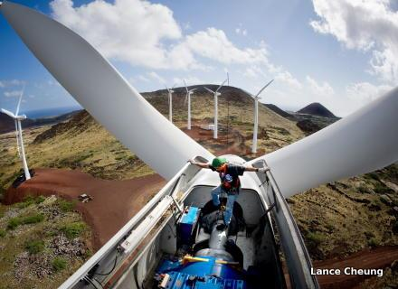
WORKING: PARTS
The huge rotor blades on the front of a wind turbine are the "turbine" part. The blades have a special curved shape, similar to the airfoil wings on a plane. When wind blows past a plane's wings, it moves them upward with a force we call lift; when it blows past a turbine's blades, it spins them around instead. The wind loses some of its kinetic energy (energy of movement) and the turbine gains just as much. As you might expect, the amount of energy that a turbine makes is proportional to the area that its rotor blades sweep out; in other words, the longer the rotor blades, the more energy a turbine will generate. Obviously, faster winds help too: if the wind blows twice as quickly, there's potentially eight times more energy available for a turbine to harvest. That's because the energy in wind is proportional to the cube of its speed.

Slide 5
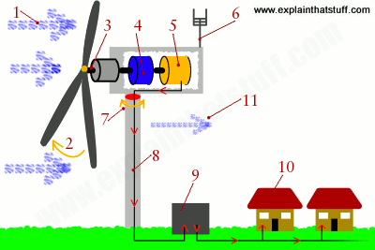
WORKING: PARTS
In most large modern turbines, the rotor blades can swivel on the hub at the front so they meet the wind at the best angle (or "pitch") for harvesting energy. This is called the pitch control mechanism. On big turbines, small electric motors or hydraulic rams swivel the blades back and forth under precise electronic control. On smaller turbines, the pitch control is often completely mechanical. However, many turbines have fixed rotors and no pitch control at all.

Slide 6
WORKING: PARTS
Inside the nacelle (the main body of the turbine sitting on top of the tower and behind the blades), the gearbox converts the low-speed rotation of the drive shaft (perhaps, 16 revolutions per minute, rpm) into high-speed (perhaps, 1600 rpm) rotation fast enough to drive the generator efficiently.

Slide 7
WORKING: PARTS
The generator, immediately behind the gearbox, takes kinetic energy from the spinning drive shaft and turns it into electrical energy. Running at maximum capacity, a typical 2MW turbine generator will produce 2 million watts of power at about 700 volts.
Anemometers (automatic speed measuring devices) and wind vanes on the back of the nacelle provide measurements of the wind speed and direction.

Slide 8
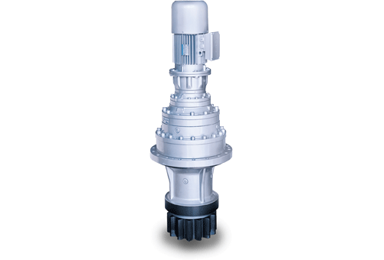
Using these measurements, the entire top part of the turbine (the rotors and nacelle) can be rotated by a yaw motor, mounted between the nacelle and the tower, so it faces directly into the oncoming wind and captures the maximum amount of energy. If it's too windy or turbulent, brakes are applied to stop the rotors from turning (for safety reasons). The brakes are also applied during routine maintenance.

Slide 9
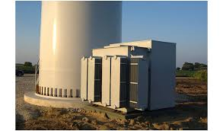
WORKING: PARTS
A step-up transformer converts the electricity to about 50 times higher voltage so it can be transmitted efficiently to the power grid (or to nearby buildings or communities). If the electricity is flowing to the grid, it's converted to an even higher voltage (130,000 volts or more) by a substation nearby, which services many turbines.

Slide 10
Pros -No air or water pollution. -No environmental impacts from mining or drilling. -No fuel to pay for—ever! -Completely sustainable—unlike fossil fuels, wind will never run out. -Turbines work almost anywhere in the world where it's reliably windy, unlike fossil-fuel deposits that are concentrated only in certain regions. -Unlike fossil-fueled power, wind energy operating costs are predictable years in advance. -Freedom from energy prices and political volatility of oil and gas supplies from other countries. -Wind energy prices will become increasingly competitive as fossil fuel prices rise and wind technology matures. -New jobs in construction, operation, and manufacture of turbines.

Slide 11
Cons -High up-front cost (just as for large nuclear or fossil-fueled plants). -Economic subsidies needed to make wind energy viable (though other power forms are subsidised too, either economically or because they don't pay the economic and social cost of the pollution they make). -Extra cost and complexity of balancing variable wind power with other forms of power. -Extra cost of upgrading the power grid and transmission lines, t-hough the whole system often benefits. -Variable output—though that problem is reduced by operating wind farms in different areas and (in the case of Europe) using -interconnectors between neighboring countries. -Large overall land take—though at least 95 percent of wind farm land can still be used for farming, and offshore turbines can be built at sea. -Can't supply 100 percent of a country's power all year round, the way fossil fuels, nuclear, hydroelectric, and biomass power can. Loss of jobs for people working in mining and drilling.

Slide 12
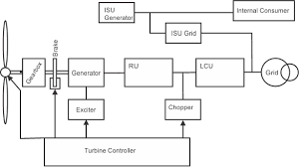
When the wind strikes the rotor blades, blades start to rotating. rotor is directly connected to high speed gearbox. gearbox converts the rotor rotation into high speed which rotates the electrical generator. an exciter is needed to give the required excitation to the coil so that it can generate required voltage. the exciter current is controlled by a turbine controller which senses the wind speed based on that it calculate the power what we can achieve at that particular wind speed. then output voltage of electrical generator is given to a rectifier and rectifier output is given to line converter unit to stabilize the output ac that is feed to the grid by a high voltage transformer. an extra units is used to give the power to internal auxiliaries of wind turbine (like motor, battery etc.), this is called internal supply unit. isu can take the power from grid as well as from wind. chopper is used to dissipate extra energy for safety purpose.
Wind Turbines

Slide 13
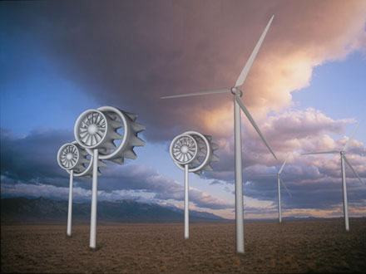
A Loopwing Turbine there are many design ideas that increase the efficiency and practicality of turbines, making them safer and even quieter. one is the loopwing, a japanese invention, which features looped blades which cut down on noise and vibrations, and make it safer. it also requires a very low wind speed to start- only 1.6mph. another new breed of turbine is the mixer ejector wind turbine (mewt). the mewt design creates a low pressure area within the turbine to suck in even more wind and generate more energy, making it more efficient than traditional wind turbines.

Slide 14
A Fast-Growing Industry Despite these difficulties, wind power is rapidly developing in practically every part of the world, with growth rates ranging from 10 to 40% per year. Although the pace of growth slackened in 2013, installed global capacity reached an impressive 318 GW, for an increase of 200 GW in five years¹. The European Union is particularly well positioned, thanks to its assertive policy of developing renewable energies. In 2013, wind power accounted for 117 GW of installed capacity. The power generation capacity of a particular plant. It is usually expressed in megawatts (or sometimes even gigawatts)... in the E.U., meeting 8% of its electricity demand.² The industry continues to grow despite a decrease in 2013.

Slide 15
Kite Power Systems is a U.K. company developing a new way to draw power from the wind using specially-designed kites that fly in pairs hundreds of feet above the ground, taking turns extending and retracting. Their motion powers a generator on the ground, which can produce kilowatts to megawatts of power, depending on the size of the kites

